Slide 1
Gestione Week Hospital
LM-41 Medicina TD - PGSS A.A. 23/24
Mimmo Conforti

Slide 2



UNIVERSITA’ DELLA CALABRIA
Vincoli
Modalità di ammissione: vincoli (1)
Modalità di fruizione dei servizi: vincoli (2), (3), (4)
Modalità di ammissione in relazione alla fruizione dei servizi: vincoli (5), (6)
Occupazione posto letto in relazione a:
Ammissione: vincoli (7)
Disponibilità letti: vincoli (8)
Fruizione dei servizi: vincoli (9)
Durata del ricovero: vincoli (10)

Slide 3







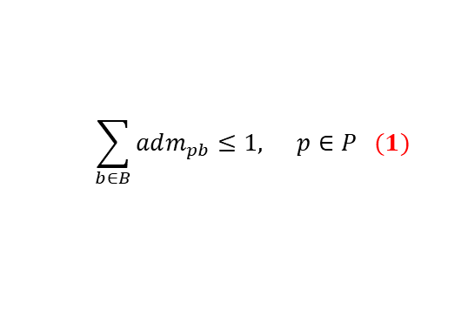




$$\sum_{b∈B}{adm_{pb}}≤1\text{, }p∈P (1)$$
$$(2)$$
$$(3)$$
$$(5)$$
$$(4)$$
$$(6)$$
$$(7)$$
$$(9)$$
$$(8)$$
$$(10)$$
$\sum_{j=b}^{b+nb_{p}−1}{y_{pj}}≥nb_{p}adm_{pb}\text{, } p∈P,b=1,...,\left|B\right|−nb_{p}$+1
$y_{pb}=0\text{, } p∈P,b>\left|B\right|−nb_{p}$+1

Slide 4
UNIVERSITA’ DELLA CALABRIA
Pilot study within a Rheumatology Division
The Rheumatology division of “Careggi” University Hospital (Florence, Italy) is one of the most important national clinical site within its own field.
During 2009, the division performed 5,400 outpatient visits and 11,786 clinical treatments on day-hospital basis.
Sclerosis systemic, rheumatoid arthritis, psoriatic arthritis, and spondylitis rheumatology are the main treated pathologies.
Patients can be admitted to the WH for many reasons, such as advanced diagnostic tests, drug dosage tuning, stabilization and monitoring of current health conditions.
The division started to experiment WH services, devoted to both diagnostic tests and therapeutic treatments (i.e., clinical services); these are prescribed by physician by considering patient’s health history and current pathological conditions.

Slide 5
UNIVERSITA’ DELLA CALABRIA
Experimental Setting
Clinical Services of Rheumatology Division
1) Computed tomography scan 10) Scintigraphy
2) X-rays 11) Eco heart
3) Nuclear magnetic resonance 12) Holter heart
4) Biopsia 13) Esophageal manometry
5) Ecography 14) Gastroscopy
6) Eco-doppler 15) Eyes exams
7) Hematochemical analysis 16) Mammography
8) Human leucocyte antigens 17) Angiography
9) Pulmonary function test 18) Colonoscopy
Beds = 4 Capacity of Clinical Service = 2 LOS min = 2

Slide 6
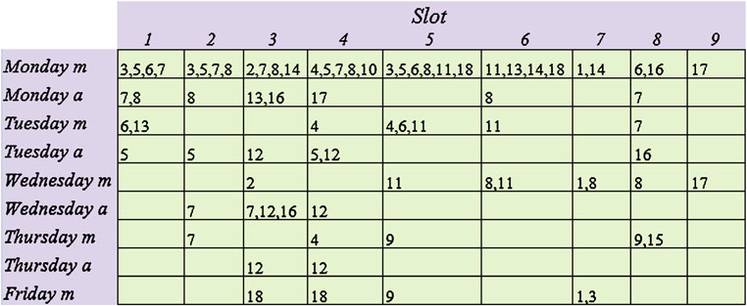
UNIVERSITA’ DELLA CALABRIA
Experimental Setting
Clinical Services Timetable

Slide 7
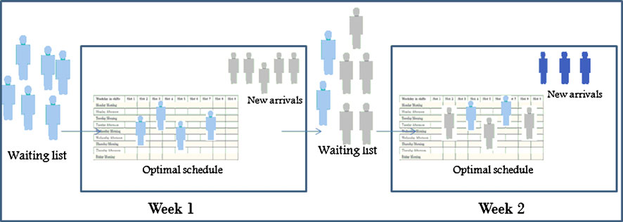
UNIVERSITA’ DELLA CALABRIA
Experimental Setting
Patient flow and decision making process for two consecutive weeks. Given a waiting list, some patients are scheduled in the first week. The unscheduled patients with new arrivals form a new waiting list, used to plan the second week

Slide 8
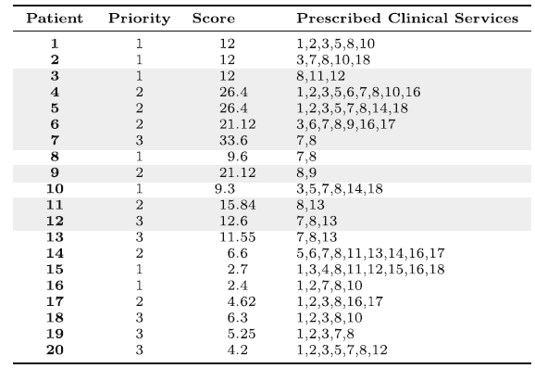
UNIVERSITA’ DELLA CALABRIA
Results
Waiting list of the First Week of Test Case 1: waiting time, priority, score, and set of prescribed clinical services

Slide 9
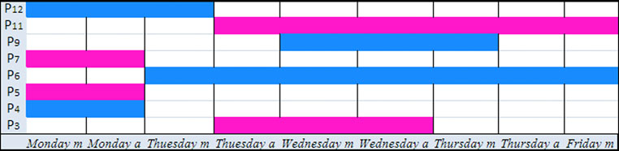
UNIVERSITA’ DELLA CALABRIA
Results
First Week of Test Case 1 : scheduled patients and LOS (m = morning, a = afternoon)

Slide 10
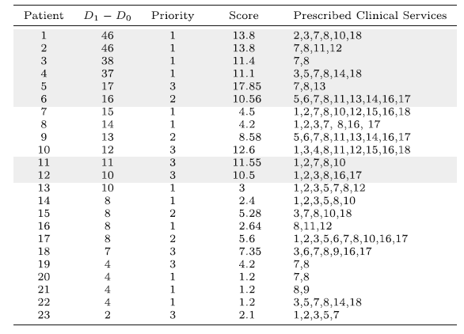
UNIVERSITA’ DELLA CALABRIA
Results
Waiting list of the Second Week of Test Case 1: waiting time, priority, score, and set of prescribed clinical services

Slide 11
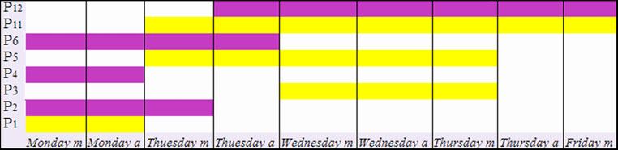
UNIVERSITA’ DELLA CALABRIA
Results
Second Week of Test Case 1 : scheduled patients and LOS (m = morning, a = afternoon)

Slide 12
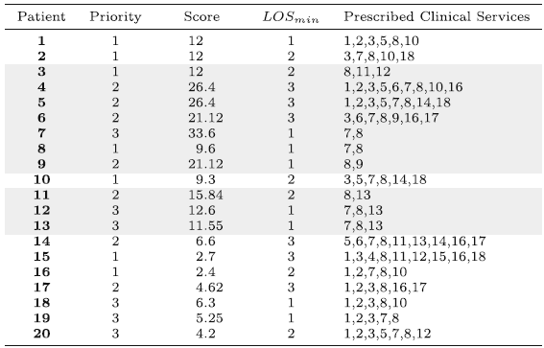
UNIVERSITA’ DELLA CALABRIA
Results
Waiting list of the First Week of Test Case 2: waiting time, priority, score, and set of prescribed clinical services

Slide 13
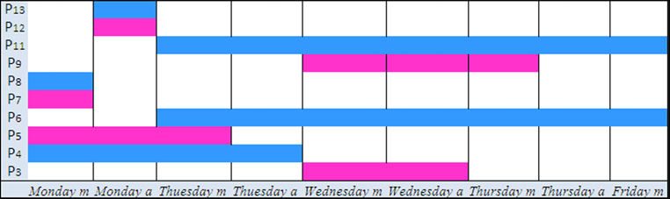
UNIVERSITA’ DELLA CALABRIA
Results
First Week of Test Case 2 : scheduled patients and LOS (m = morning, a = afternoon)

Slide 14
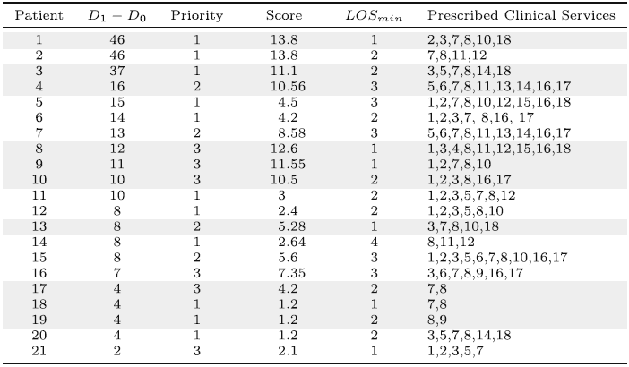
UNIVERSITA’ DELLA CALABRIA
Results
Waiting list of the Second Week of Test Case 2: waiting time, priority, score, and set of prescribed clinical services

Slide 15
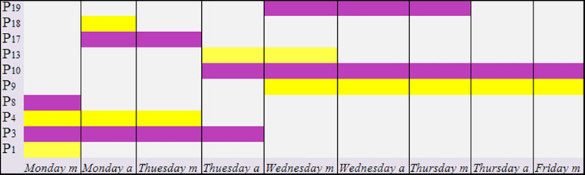
UNIVERSITA’ DELLA CALABRIA
Results
Second Week of Test Case 2 : scheduled patients and LOS (m = morning, a = afternoon)

Slide 16
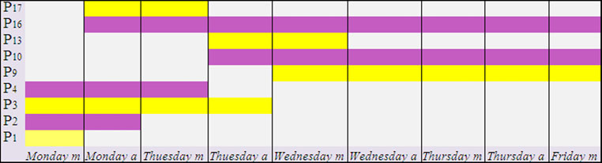
UNIVERSITA’ DELLA CALABRIA
Results
Test Case 3: scheduled patients and LOS (second week of test case 2 with capacity of clinical services 3, 7, 8 increased to 3)

Slide 17
UNIVERSITA’ DELLA CALABRIA
CONCLUSIONS (1/2)
Optimal schedules obtained by the optimisation model can be interpreted from different point of view:
from a patient perspective, since he/she knows in advance admission and discharge date (if no complication occurs) and the clinical services appointments. Any repeated admission is avoided with a consequence reduction of stress and social costs;
from a health care operator perspective since he/she knows in advance the clinical procedures to perform;
from a manager perspective, since costs and utilization of all resources are known in advance. He/she analyzes if current utilization is in line with best practice and is able to identify critical resources. A timetable is modified when changes in volume of clinical service demands or other requirements occur.

Slide 18
UNIVERSITA’ DELLA CALABRIA
CONCLUSIONS (2/2)
The application of the optimisation model may support the management of health care personnel. Since every clinical service requires a specialized medical staff, activities of personnel/staff can be planned in advance.
The proposed model can be also applied to verify if a patient could be admitted in WH. In fact, during the baseline visit, it is possible to confirm whether a patient may undergo all the clinical services during a week on the basis of the given timetable. If this is not possible, patient will not be added into the WH waiting list.

